Slide 1
Python programming 1

Slide 2
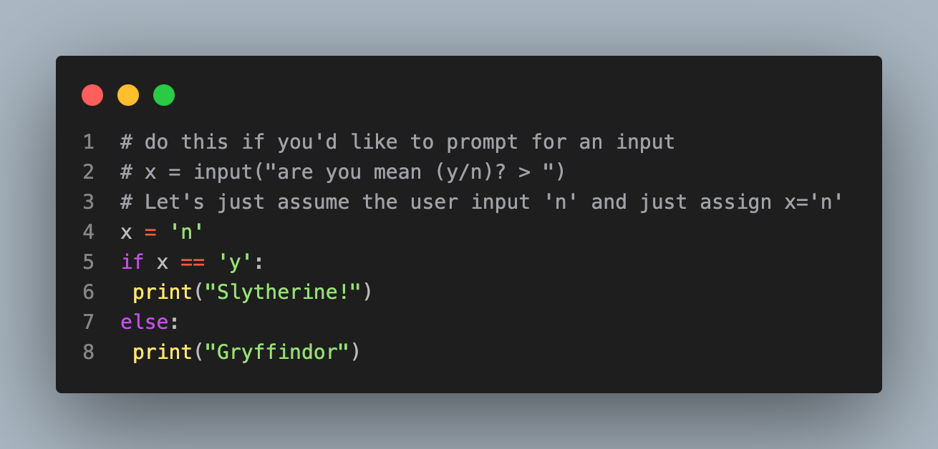
Control flow, If statements
Python has if statements like most programming languages
Notice the indentation and the:
Gryffindor

Slide 3
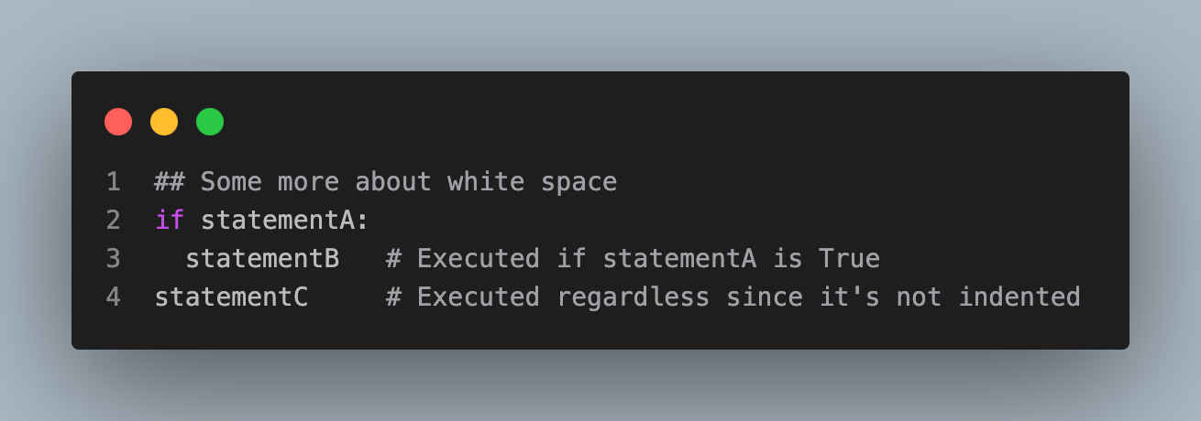
White space
White space is more meaningful in python than other languages
This is actually useful, as it forces good indentation practices

Slide 4
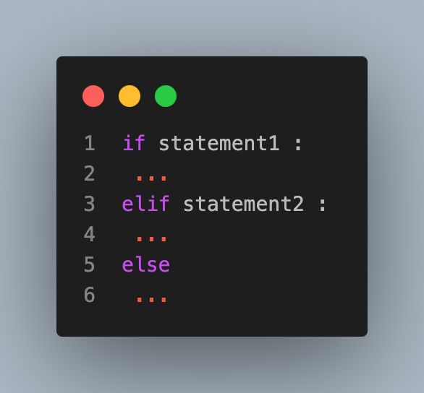
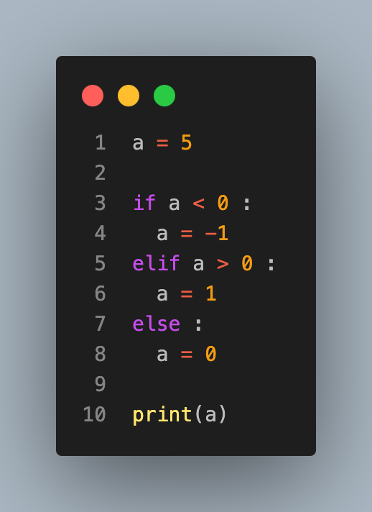
General if statement structure
Here's an example (note this is just equal to the statement (a < 0) - (a > 0))
1

Slide 5
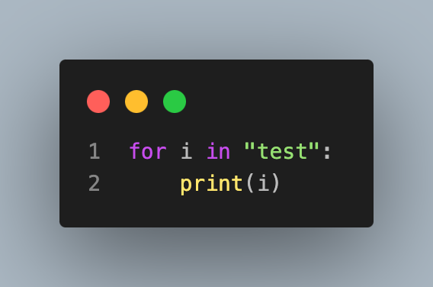
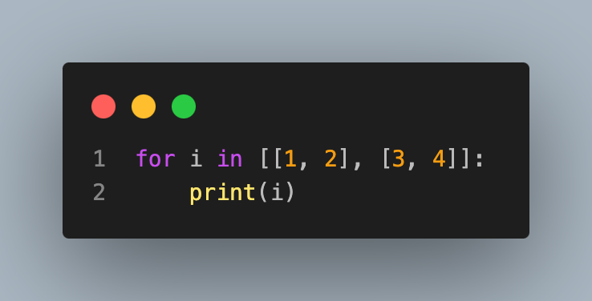
Loops in Python
Python has for and while loops
for loops will iterate over most objects for which it makes sense
Don't forget the indentation or the :
[1, 2]
[3, 4]
t
e
s
t

Slide 6
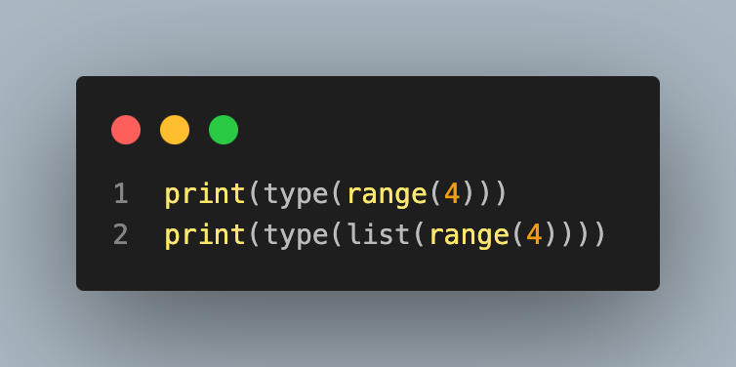
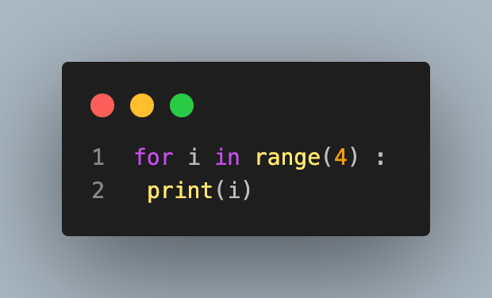
Range
range is a function that creates an iterable list of integers
range(4) is not itself a list, but list(range(4)) is
<class 'range’>
<class 'list'>
0
1
2
3

Slide 7
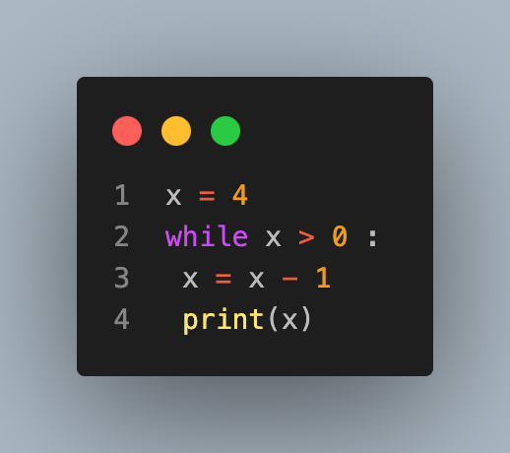
While loop example
3
2
1
0

